Slide 1
Notes for the BFS course
Statistics and Probability theory

Slide 2
Evolution of machine learning
Data reporting
Smart queries Business intelligence
Statistics with Business intelligence
Statistics with Business intelligence
Statistics + probability +Linear regression with Business intelligence
Statistics + Probability + Linear regression + machine learning with Business intelligence
Adaptive control theory
Linear regression in statistics
Artificial intelligence
Pattern recognition
Optimization and Probability
Generalized the concepts to ‘learning by training’.
Extended the concepts to ‘learning without training’.

Slide 3
From Statistics to Probability
Simply put, probability defines the pure, mathematical layout of the occurrence things while statistics embodies the nitty-gritty, real-world application of probability.
That is not to say that statistics is non-math oriented…far from it: even the shallowest dive into proper statistics theory is lousy with mathematics!
In our analysis, statistics looks at the properties of given set of data.
Probability generally details out the properties at the limiting conditions.
Tossing the coin: We say that the chance of getting ‘head’ when we flip thro is 50%. If we flip the coin 10 times, will we be getting 5 times head?
No, But as we move towards infinity the number of heads will be 50%.
This is called ‘Law of large numbers’.

Slide 4

Probability
In life, we conduct many experiments without being sure of the outcome. The experiments can be conducted under ideal conditions still the outcome may be varying. These experiments are defined as random experiments.
Example: Tossing the coin.
A set S consisting of al possible outcomes of a random experiment is called a sample space. The outcome is called sample point.
In case of finite number of points, the space is finite sample space. In case, if it has as many points as there are natural numbers, then it is countably infinite sample space.
If it has as many points as there are in some interval on the x axis such as 0<= x<=1, it is called non countably infinite sample space.
In the first case it is discrete sample space else non discrete sample space.
An event is a subset of sample space.(event can be anywhere in the subset.)
The empty set is impossible event denoted by φ.

Slide 5
Concept of probability
Two approaches:
Classical approach: If an event can occur in h different ways out of total number of n possible ways, all of which are equally likely, then the probability of the event is h/n.
Frequency approach: If after ‘n’ repetitions of an experiment, where n is very large an event is observed to occur in h of these, then the probability is h/n. This is called empirical probability of the event.
Drawbacks: First one – equally likely – not properly defined. Second one – The term ‘Large number’ is vague.
Most of the time we are dealing with variables which have numerical outcomes.
A variable which can take at least two different numerical values in a long run of repeated observations is called random variable.
A random variable is a variable whose value is a numerical outcome of a random phenomenon.

Slide 6
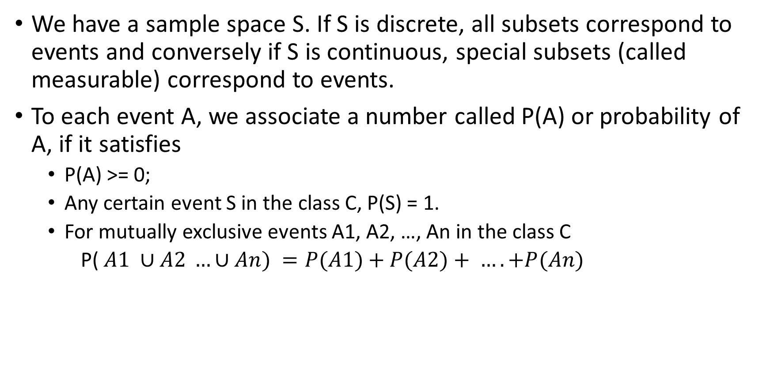
Axioms of probability
We have a sample space S. If S is discrete, all subsets correspond to events and conversely if S is continuous, special subsets (called measurable) correspond to events.
To each event A, we associate a number called P(A) or probability of A, if it satisfies
P(A) >= 0;
Any certain event S in the class C, P(S) = 1.
For mutually exclusive events A1, A2, …, An in the class C
P( $A1 ∪A2 …∪An) =P(A1)+P(A2)+ …. +P(An)$

Slide 7
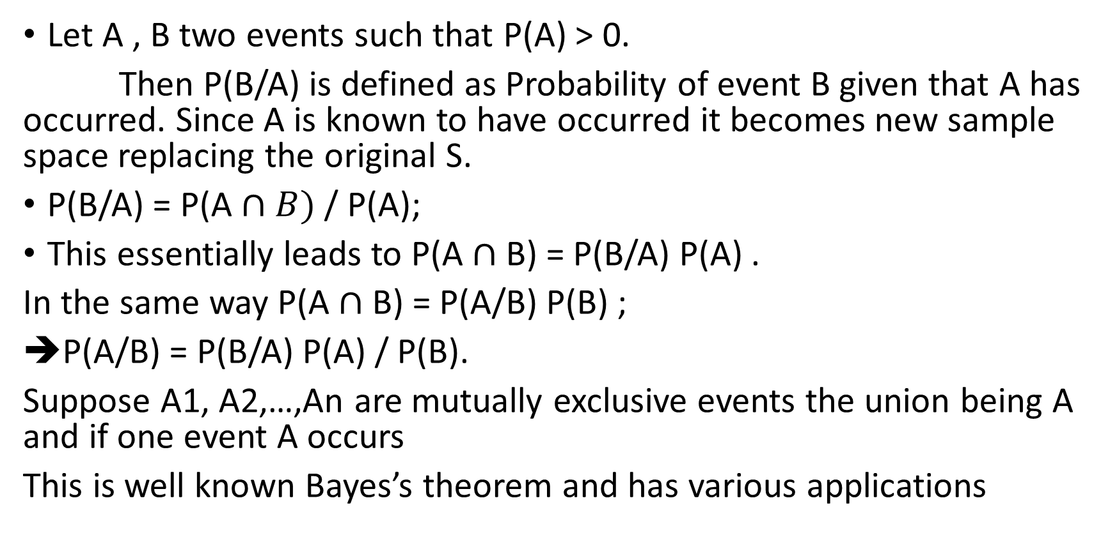
Conditional Probability
Let A , B two events such that P(A) > 0.
Then P(B/A) is defined as Probability of event B given that A has occurred. Since A is known to have occurred it becomes new sample space replacing the original S.
P(B/A) = P(A $∩B)$ / P(A);
This essentially leads to P(A $∩$B) = P(B/A) P(A) .
In the same way P(A $∩$B) = P(A/B) P(B) ;
P(A/B) = P(B/A) P(A) / P(B).
Suppose A1, A2,…,An are mutually exclusive events the union being A and if one event A occurs
This is well known Bayes’s theorem and has various applications

Slide 8
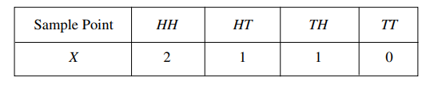
Random variables
Suppose that to each point of a sample space we assign a number. We then have a function defined on the sample space. This function is called a random variable (or stochastic variable) or more precisely a random function (stochastic function). It is usually denoted by a capital letter such as X or Y
Suppose that a coin is tossed twice so that the sample space is
S = {HH, HT, TH, TT}.
Let X represent the number of heads that can come up. With each sample point we can associate a number for X.
We usually denote random variables by capital letters near the end of the alphabet, such as X or Y . Some values of the random variable X may be more likely than others.
The probability distribution of the random variable X lists the possible outcomes together with their probabilities the variable X can have.

Slide 9
Discrete probability distribution
Probability distribution of a discrete random variable:
A discrete random variable X has a countable number of possible values. The probability distribution of X lists the values and their probabilities:
Value of X x1 x2 x3 . . . xk
Probability P(x1) P(x2) P(x3) . . . P(xk)
The probabilities P(xi) must satisfy two requirements:
1) Every probability P(xi) is a number between 0 and 1.
2) P(x1) + P(x2) + · · · + P(xk) = 1.

Slide 10
Continuous random variable
A continuous random variable X takes all values in an interval of numbers [a, b].
The probability distribution of X describes the probabilities
P(x1 <= X <= x2) of all possible intervals of numbers [x1, x2].
The probabilities P(x1 <= X <= x2) must satisfy two requirements:
For every interval [x1, x2], the probability P(x1 <= X <= x2) is a number between 0 and 1.
P(a <= X <= b) = 1.
The probability distribution of a continuous random variable is pictured by a density curve.
A density curve is smooth continuous curve having area exactly 1 underneath it such like curves representing the population distribution

Slide 11
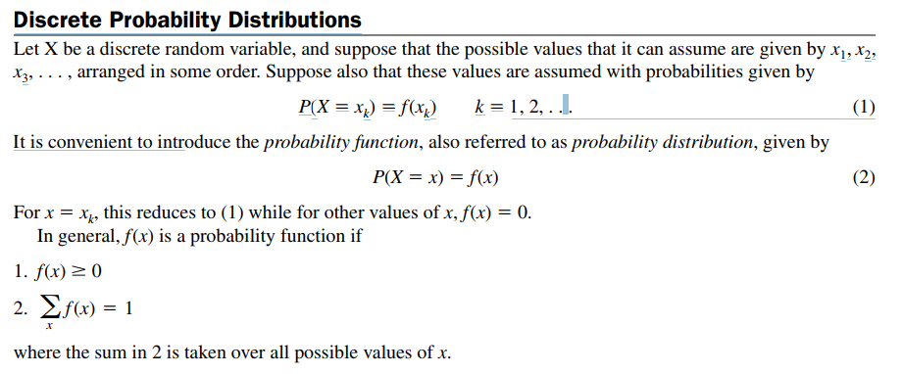

Slide 12
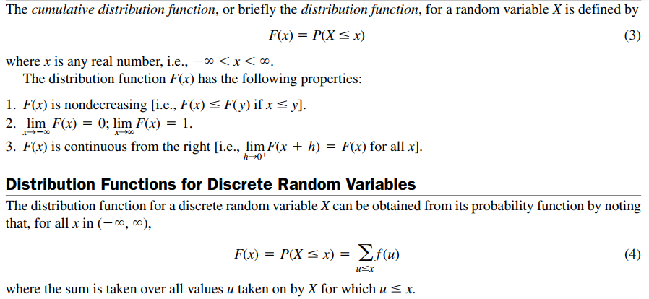
Density and distribution function

Slide 13
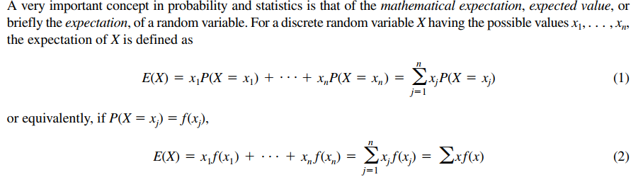

Mean or Expectation
If all f(x1) = f(x2) =….=f(xn) then E(X) = (x1+x2+…+xn)/n.

Slide 14




Variance and standard deviation

Slide 15
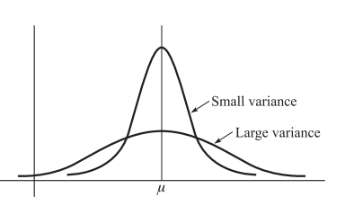

Slide 16


Binomial distribution
Let ‘p’ be the probability that an event will happen in any single Bernoulli trial (called the probability of success). Then q = 1- p is the probability that the event will fail to happen in any single trial (called the probability of failure).
The probability that the event will happen exactly x times in n trials (i.e., successes and n x failures will occur) is given by the probability function
where the random variable X denotes the number of successes in n trials and x = 0, 1, . . . , n.
This can be proved by analogous problem called filling r boxes with ‘n’ balls. The permutations in this case is n.(n-1)…(n-x-1). Limiting ourselves only to combinations we get the above result.
(Law of Large Numbers for Bernoulli Trials): Let X be the random variable giving the number of successes in n Bernoulli trials, so that is the proportion of successes. Then if p is the probability of success and ε is any positive number,

Slide 17
Examples: Binomial distribution
— The number of heads/tails in a sequence of coin flips
— Vote counts for two different candidates in an election
— The number of male/female employees in a company
— The number of accounts that are in compliance or not in compliance with an accounting procedure
— The number of successful sales calls — The number of defective products in a production run
— The number of days in a month your company’s computer network experiences a problem

Slide 18
The Poisson distribution
The Poisson distribution is another family of distributions that arises in a great number of business situations. It usually is applicable in situations where random “events” occur at a certain rate over a period of time.
Examples:
— The hourly number of customers arriving at a bank
— The daily number of accidents on a particular stretch of highway
— The hourly number of accesses to a particular web server
— The daily number of emergency calls in Dallas
— The number of typos in a book
— The monthly number of employees who had an absence in a large company
— Monthly demands for a particular product

Slide 19
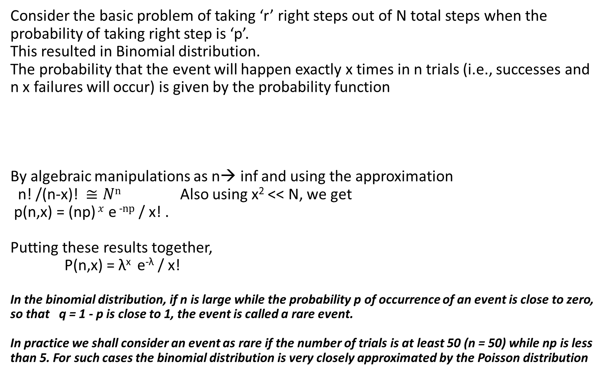
Consider the basic problem of taking ‘r’ right steps out of N total steps when the probability of taking right step is ‘p’. This resulted in Binomial distribution. The probability that the event will happen exactly x times in n trials (i.e., successes and n x failures will occur) is given by the probability function By algebraic manipulations as n→ inf and using the approximation n! /(n-x)! $≅Nn$ Also using x² << N, we get p(n,x) = (np) $x$ e ⁻$np$ / x! . Putting these results together, P(n,x) = λ^{x} e^{-λ} / x! In the binomial distribution, if n is large while the probability p of occurrence of an event is close to zero, so that q = 1 - p is close to 1, the event is called a rare event. In practice we shall consider an event as rare if the number of trials is at least 50 (n = 50) while np is less than 5. For such cases the binomial distribution is very closely approximated by the Poisson distribution

Slide 20
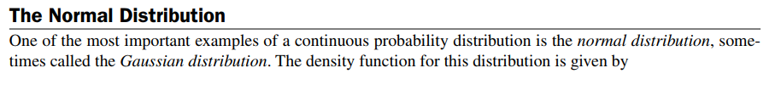



Gaussian – Normal distribution
where ‘μ’ is the mean and σ is the standard distribution. If we substitute z = ( x- μ)/ σ.
The distribution function is given by

Slide 21
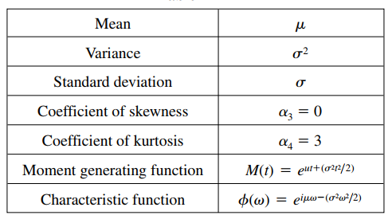


Normal from Binomial distribution
the standardized random variable Z is asymptotically normal

Slide 22
Probability distributions
Probability distributions are fundamental to statistics, just like data structures are to computer science.
They’re the place to start studying if you mean to talk like a data scientist.
You can sometimes get away with simple analysis using R or scikit-learn without quite understanding distributions, just like you can manage a Java program without understanding hash functions.
But it would soon end in tears, bugs, bogus results, or worse: sighs and eye-rolling from stats majors.
An example: Flipping a fair coin has two outcomes: it lands heads or tails. (Assume it can’t land on edge or be stolen by a seagull in mid-air.) Before the flip, we believe there’s a 1 in 2 chance, or 0.5 probability, of heads. The same is true for tails.

Slide 23
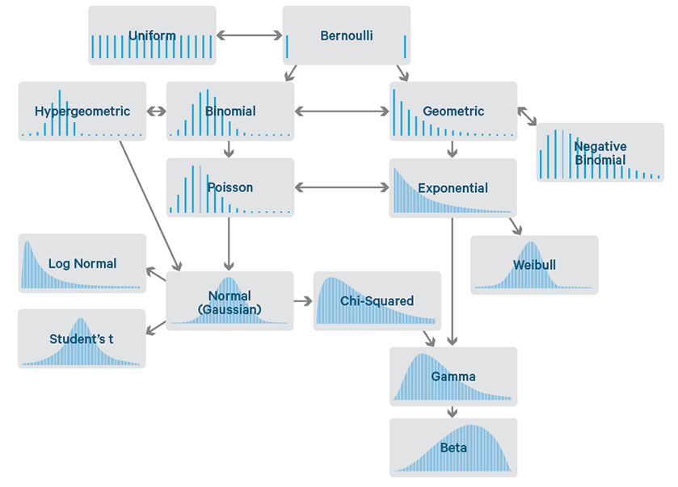
Different types of distributions

Slide 24
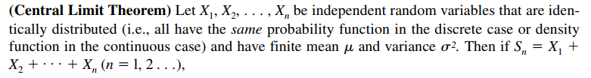

Central limit theorem

Slide 25
Important distributions
From Bernouli distribution, we derive Binomial, then Poisson and Gaussian by considering limiting conditions.
Gaussian is defined in terms of mean and variance, two fundamental statistical quantities.
3 more distributions for machine learning purposes – They are
Chi square
Now, when we consider limited samples, the distribution of the variances is analyzed which gives rise to chi square distribution.
T distribution
Analysis of means is analyzed by evaluating the distribution of the ratio of mean to variance ( Normal/Chi square) that gave rise to ‘t’ distribution. ( Distribution of means with less no. of samples)
F distribution:
Analyzing the distribution of the ratio of the variances gave rise to ‘F’ distribution which appear in Analysis of Variance.

Slide 26
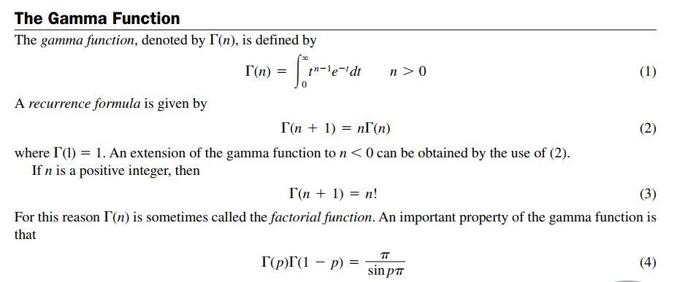
Appendix - The Gamma function

Slide 27
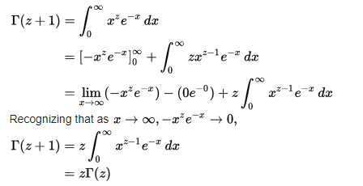
Appendix - Gamma function
There came a question whether a smooth curve can be found thro the points (x, y) where y= (x-1)!.
Essentially, generalize the definition of factorial to real numbers. The problem will be with fractional points.
Ultimately they have to satisfy the property
f(x+1) = x f(x).
When they investigated, a function has been found out as

Slide 28
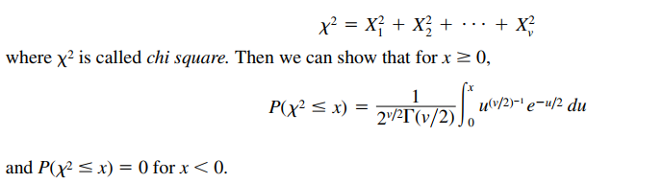
Appendix - Chi square

Slide 29
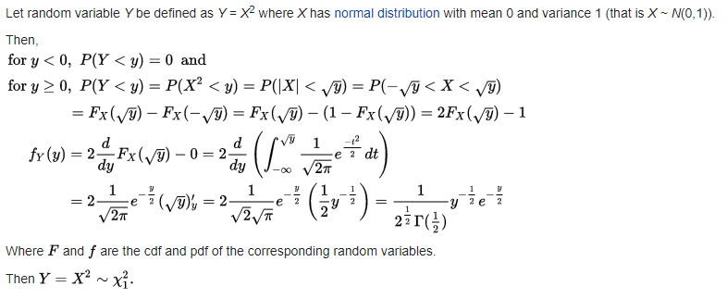
Appendix - Derivation of chi square distribution

Slide 30
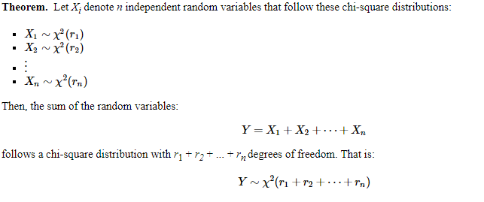
Appendix - Chi square distributions - properties

Slide 31
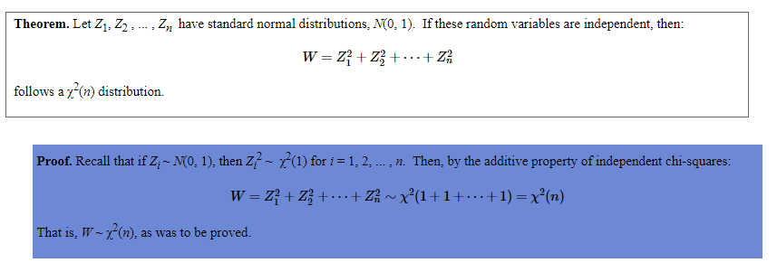

Slide 32

Summary - Normal distribution
Summarizing,
A Gaussian distribution is the probability density function described by mean and variance and given as
Suppose we let z = (x-μ)/σ, we get standard normal distribution as (σ² = 1)
A continuous random variable Z is said to have a standard normal distribution if Z is normally distributed with mean μ = 0 and standard deviation = 1, i.e., Z N(0, 1)..
The standard normal table can be used to calculate probabilities concerning the random variable Z.
The standard normal table gives area to the left of a specified value of z under density curve:
P(Z <= z) = Area under curve to the left of z.
For the probability of an interval [a, b]:
P(a <= Z <= b) = [Area to left of b] − [Area to left of a].

Slide 33
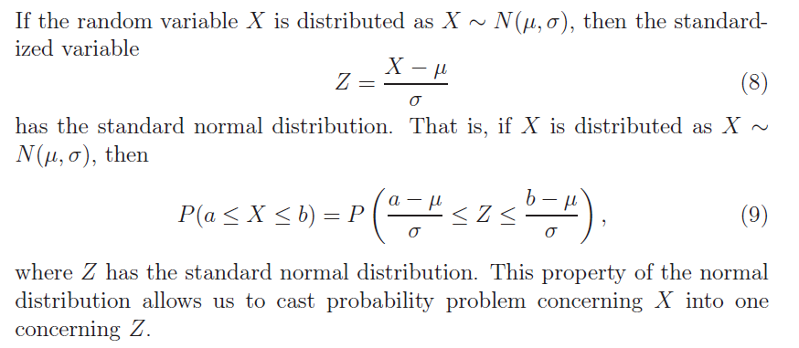
Standardized variable Z

Slide 34
Sampling
Statistical inference draws conclusions about population on the basis of data.
The data are summarized by statistics such as the sample mean and the sample standard deviation.
When the data are produced by random sampling or randomized experimentation, a statistic is a random variable that obeys the laws of probability theory.
The link between probability and data is formed by the sampling distributions of statistics.
A sampling distribution shows how a statistic would vary in repeated data production.

Slide 35
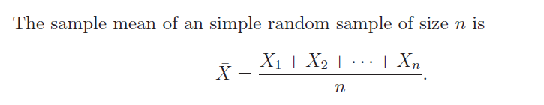
Sampling statistic
A sampling distribution is a probability distribution that determines probabilities of the possible values of a sample statistic.
Consider a simple ‘n’ samples from a population.
The data consists of ‘n’ random variables X₁,X₂, …., .
Now each one of Xi can be considered as independent random variables having the probability distribution of the original X with the same and variance.

Slide 36
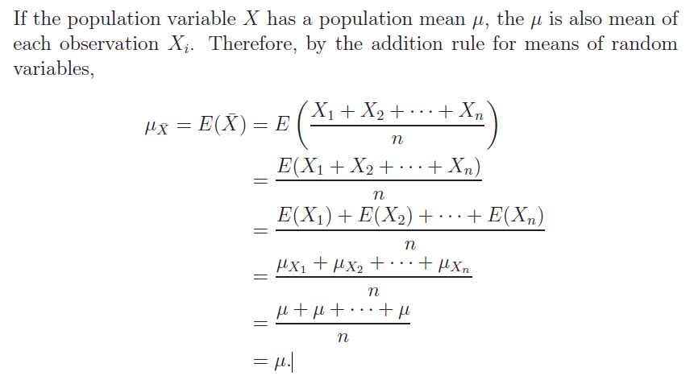
Mean of sample means is the population mean

Slide 37
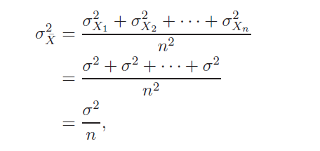
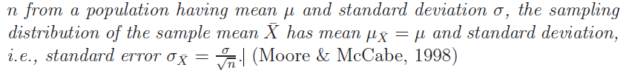
Sample means form normal distribution with less variance
Similarly Xbar ( ) has the variance
This result essentially justifies machine learning algorithms to use sampled data and run multiple experiments to get the parameters with less variance.

Slide 38
Applications - Estimation
Population – sample. In these two, population refers to the whole data set and sample refers to a subset.
When we make conclusions based on the samples data set, how far the results are valid? What are all the conditions? These ideas form the sound footing for analysis of machine learning algorithms.
Definition:
A point estimator of a unknown population parameter is a statistic that estimates the value of that parameter.
A point estimate of a parameter is the value of a statistic that is used to estimate the parameter.

Slide 39

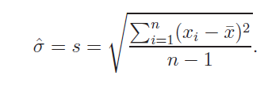
Sample mean and standard deviation
For instance, to estimate a population mean μ, perhaps the most intuitive point estimator is the sample mean:
A point estimator is called unbiased if its sampling distribution centers around the parameter in the sense that the parameter is the mean of the distribution.
An estimator whose standard error is smaller than those of other potential estimators is said to be efficient.
The sample standard deviation is given by

Slide 40


Summary of results in sampling
Fact1:
The mean of the sampling distribution of means, denoted by is given by E(Xbar) = μ(Xbar) = μ where μ is the mean of the population.
Fact 2:
If a population is infinite and the sampling is random or if the population is finite and sampling is with replacement, then the variance of the sampling distribution of means is given by
Fact 3:
If the population is of size N, if sampling is without replacement, and if the sample size is n<= N then

Slide 41
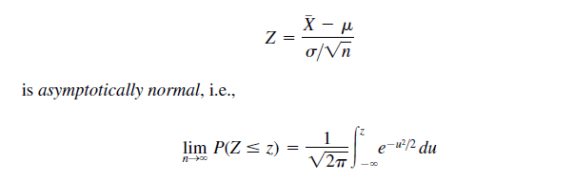
Summary of the results
Fact 4:
If the population from which samples are taken is normally distributed with mean μ and σ² variance then the sample mean is normally distributed with mean μ and variance σ² / n.
Fact 5:
Suppose that the population from which samples are taken has a probability distribution with mean μ and variance σ² that is not necessarily a normal distribution. Then the standardized variable associated with Xbar given by

Slide 42
Degrees of freedom and confidence level
In sampling analysis, we presume either the mean or std deviation is fixed. Hence, If there are ‘n’ variables only ‘n-1’ have the freedom to move around and one will be fixed based on the assumed mean or std deviation.
Instead of std error, it is often more desirable to produce an interval of values that is likely to contain the true value of the unknown parameter.
A confidence interval estimate of a parameter consists of an interval of numbers obtained from a point estimate of the parameter together with a percentage that specifies how confident we are that the parameter lies in the interval.
The confidence percentage is called the confidence level.

Slide 43



Confidence level of sample means when std dev is known
A motivation:
The distribution of estimated mean values is given by
The normal table shows that the probability is 0.95 that a normal random variable will lie within 1.96 standard deviations from its mean. After some manipulations, the following relation can be obtained.
We can conclude, is a 95% confidence
interval for μ when population variable X is normally distributed and standard deviation of the population is known.

Slide 44

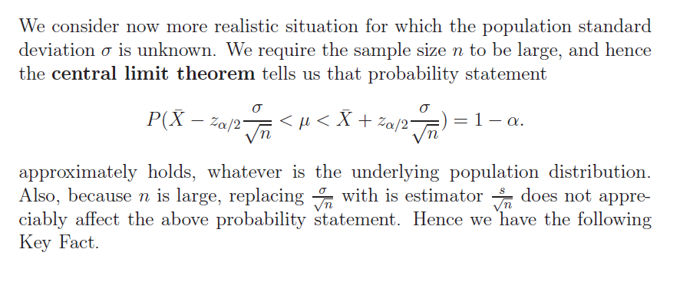
A 100(1 – α) % confidence interval is given by

Slide 45
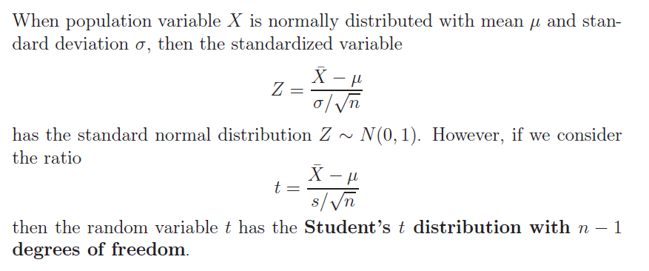
Standard normal and ‘t’ distribution
What is the formula for is ‘t’ distribution and how was it derived for small sample sets?

Slide 46


Confidence intervals for mean- Examples
The Normal table:
A random variable normally distributed has a mean μ and standard deviation σ.
The cumulative distribution is given y

Slide 47
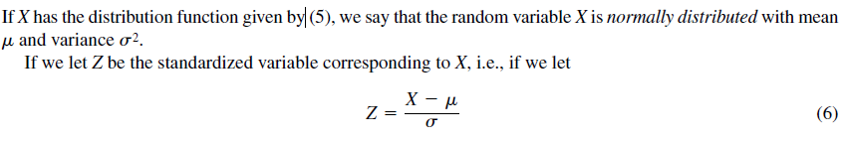

Slide 48
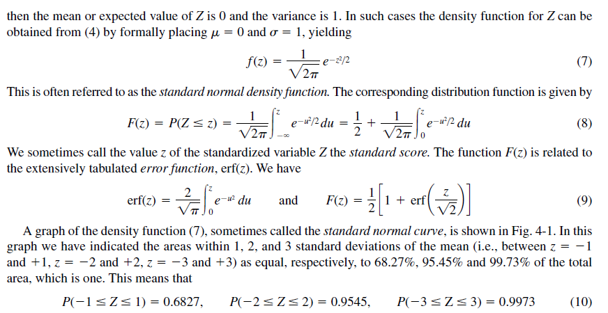

Slide 49
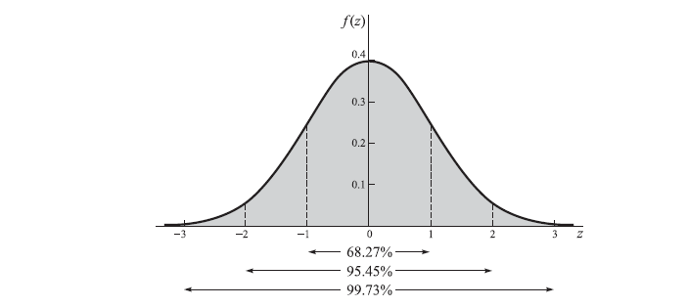

Slide 50
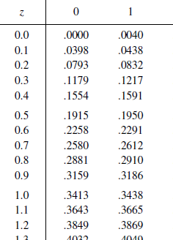
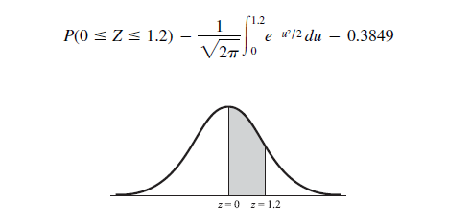
Examples: Find the area under the normal curve
Find the area under the standard normal curve (a) between z = 0 and z = 1.2, (b) between z0.68 and z0, (c) between z0.46 and z2.21, (d) between z0.81 and z1.94, (e) to the right of z1.28.
(a)

Slide 51
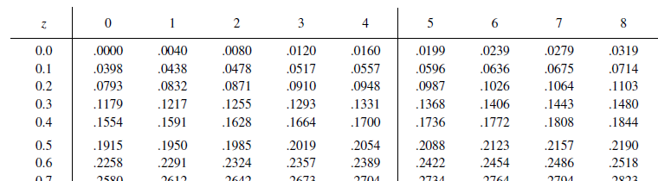
Normal distribution
(b) Area between 0 and .68

Slide 52
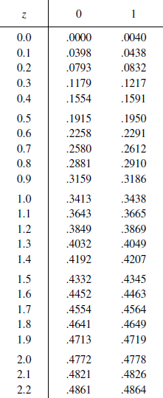
Finding the area- a few techniques)
between z-0.46 and z2.21
Idea: Find the area between 0 and 2.21 and 0 and
.46 and add..
For 2.21, the table value is .4864 and for .46 it is .1772.
Hence the area is .6636

Slide 53
Using R for Normal tables
Problem
Assume that the test scores of a college entrance exam fits a normal distribution. Furthermore, the mean test score is 72, and the standard deviation is 15.2. What is the percentage of students scoring 84 or more in the exam?
Solution
We apply the function pnorm of the normal distribution with mean 72 and standard deviation 15.2. Since we are looking for the percentage of students scoring higher than 84, we are interested in the upper tail of the normal distribution.
> pnorm(84, mean=72, sd=15.2, lower.tail=FALSE) [1] 0.21492
Answer
The percentage of students scoring 84 or more in the college entrance exam is 21.5%.

Slide 54
Applications (Exercise. Use R command)
The mean weight of 500 male students at a certain college is 151 lb and the standard deviation is 15 lb.
Assuming that the weights are normally distributed, find how many students weigh (a) between 120 and 155 lb, (b) more than 185 lb.
Point: from ‘Weight 120lb’ can mean 119.5 onwards.
Transform 119.5 in standard units z = (119.5 – mean) / std dev as
=(119.5 – 151)/15 = -2.10.
For 155, we take 155.5 and standard units is (119.5 – 155.5)/ 15 = .30.
The area under the normal curve between -2.10 and .30 is computed from th e tables as .4821 + .1179 = .6000.
.6000 * Total 500 = 300 students as the area under the curve in normalized table is 1 wheareas the actual curve covers the total population.
R command:
Try the command pnorm( 120, mean = <>, sd=<>, lower.tail=FALSE) also for 155, get the difference, convert into percentage. You should get 300.

Slide 55
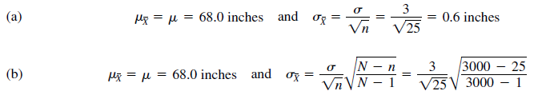
Sampling – example problem
Assume that the heights of 3000 male students at a university are normally distributed with mean 68.0 inches and standard deviation 3.0 inches. If 80 samples consisting of 25 students each are obtained, what would be the mean and standard deviation of the resulting sample of means if sampling were done (a) with replacement, (b) without replacement?
The numbers of samples of size 25 that could be obtained theoretically from a group of 3000 students with and without replacement are (3000)**25 and 3000C25, which are much larger than 80.
Hence, we do not get a true sampling distribution of means but only an experimental sampling distribution.
Nevertheless, since the number of samples is large, there should be close agreement between the two sampling distributions.
Hence, the mean and standard deviation of the 80 sample means would be close to those of the theoretical distribution. Therefore, we have

Slide 56
Confidence intervals
Let and be the mean and standard deviation (standard error) of the sampling distribution of a statistic S.
Then, if the sampling distribution of S is approximately normal (which as we have seen is true for many statistics if the sample size ), we can expect to find S lying in the intervals to , to or to about 68.27%, 95.45%, and 99.73% of the time, respectively.
Equivalently we can expect to find, or we can be confident of finding, in the intervals to , to or to about 68.27%, 95.45%, and 99.73% of the time, respectively.
Because of this, we call these respective intervals the 68.27%, 95.45%, and 99.73% confidence intervals for estimating (i.e., for estimating the population parameter, in the case of an unbiased S).
The end numbers of these intervals ( ) are then called the 68.27%, 95.45%, and 99.73% confidence limits.
Similarly, and are 95% and 99% (or 0.95 and 0.99) confidence limits for .
The percentage confidence is often called the confidence level. The numbers 1.96, 2.58, etc., in the confidence limits are called critical values, and are denoted by zc. From confidence levels we can find critical values, and conversely.

Slide 57
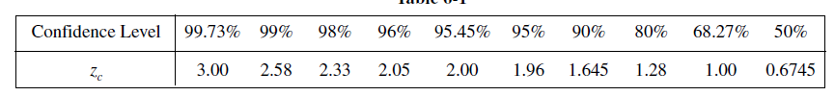
Useful table

Slide 58
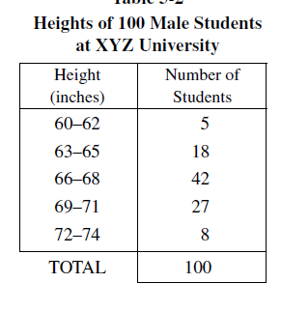
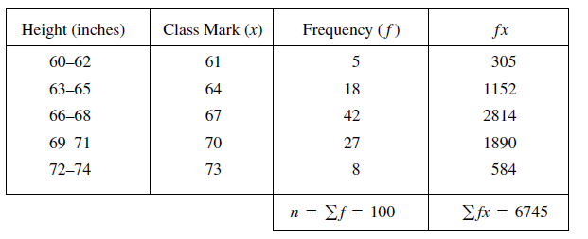
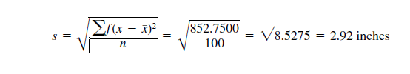
Exercise for confidence interval
Data
Stage 2 – Computation of the mean
This was obtained from computing E(X-XBAR)**2)

Slide 59
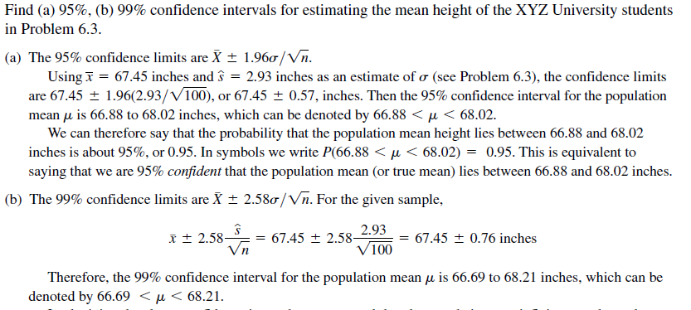
Ref: Schaum series in Probability and statistics

Slide 60
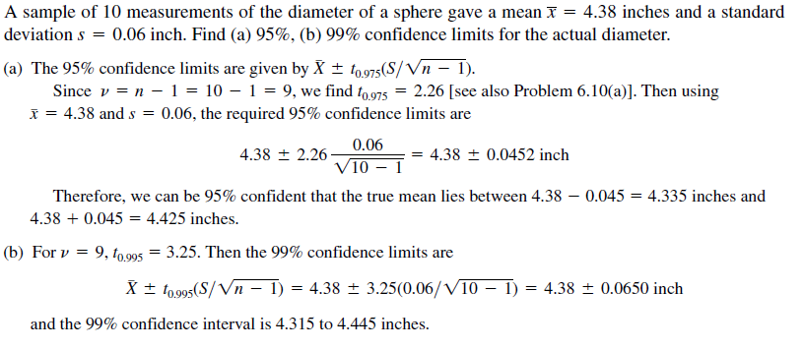
Small samples – t distribution

Slide 61
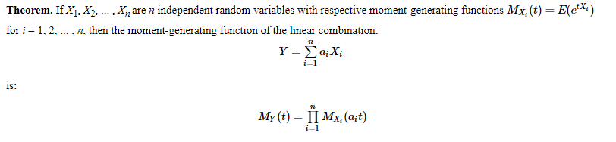
Appendix : ‘t’ distribution
Basic theorem: The sample means are normally distributed.
Proof:
We define a function called Moment generating function’ as
expected value of e^{(t X)} = E(e^{(t X)} )
The next result will be ( Addition corresponds to multiplication)

Slide 62
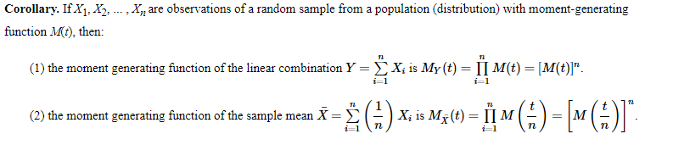
Appendix
These above relations directly lead to find the celebrated result that the sampled means of normally distributed variables are normally distributed.
This essentially leads to ‘t’ distribution.

Slide 63
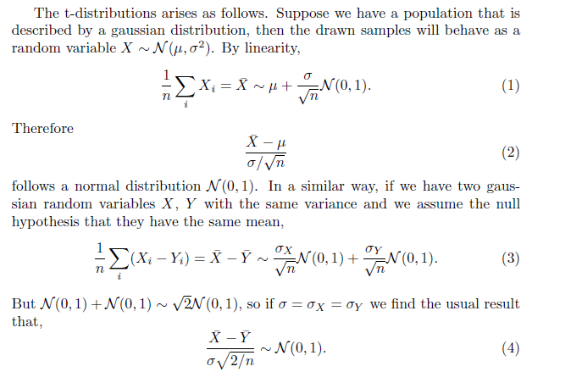
T distribution

Slide 64
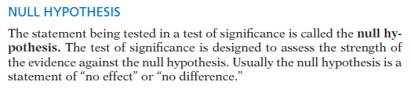
Hypothesis
It is convenient also to give a name to the statement we hope or suspect is alternative hypothesis true instead of H0. This is called the alternative hypothesis and is abbreviated as Ha.
To assess how far the estimate is from the parameter, standardize the estimate.
In many common situations the test statistic has the form
z = (estimate − hypothesized value ) / standard deviation of the estimate.
P-VALUE
The probability, assuming H0 is true, that the test statistic would take a value as extreme or more extreme than that actually observed is called the P-value of the test. The smaller the P-value, the stronger the evidence against H0 provided by the data.

